Slide 1




CREDIT RISK PREDICTION
Itatri Lestari
https://www.linkedin.com/in/itatri-lestari-8831a4247/
2023

Slide 2




Problem Statement
A lending company asks to create a model that can predict credit risk using a data set provided by the company which consists of data on loans accepted and rejected.
FINAL TASK
02

Slide 3
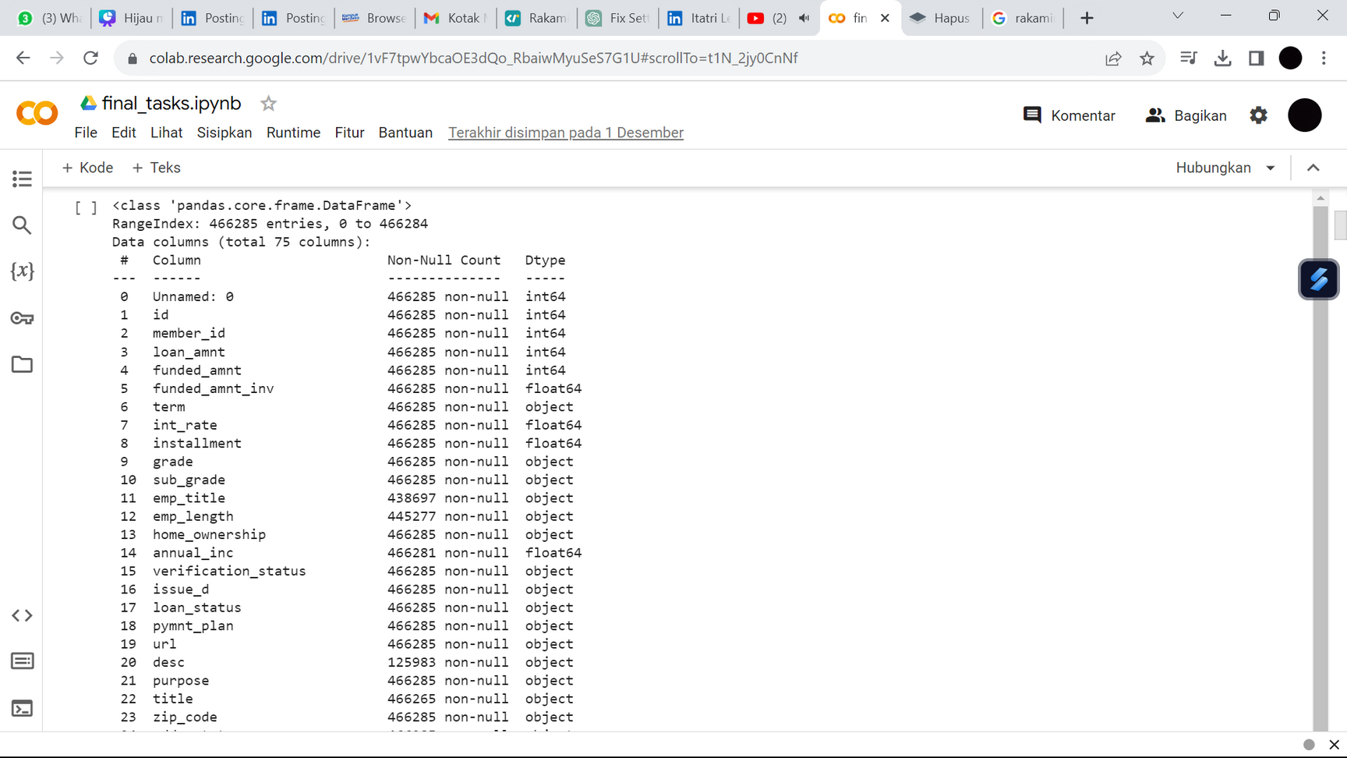
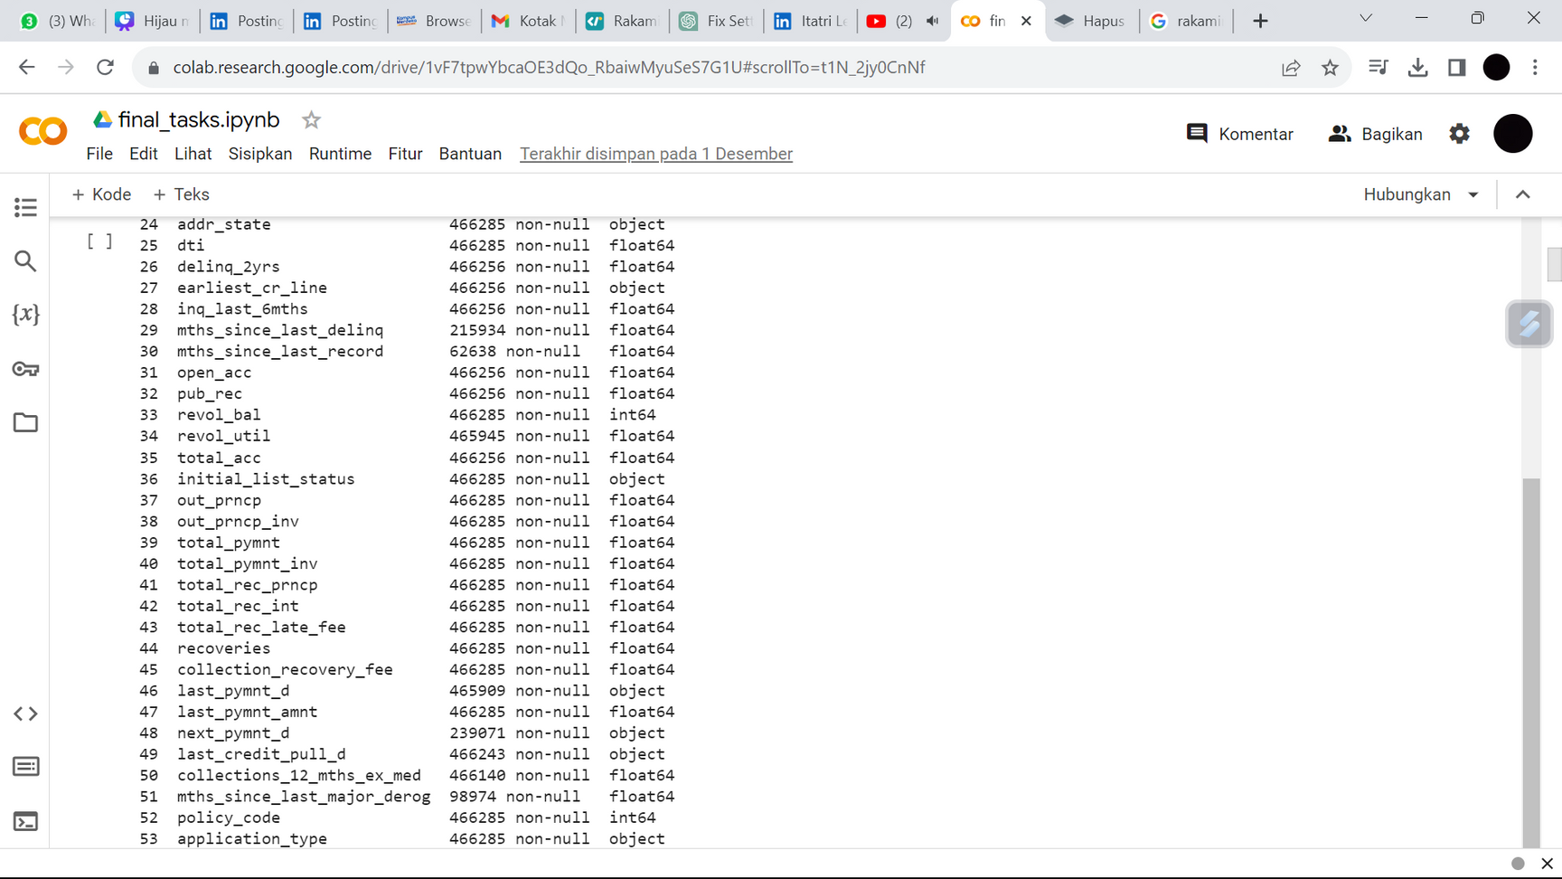
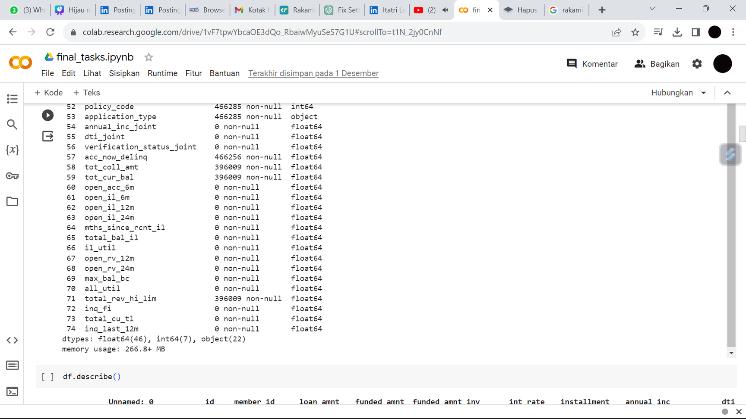
Data Understanding
Dataset have 466285 rows with 75 columns.
Include multiple data types (float, int, and object).
03
FINAL TASK

Slide 4

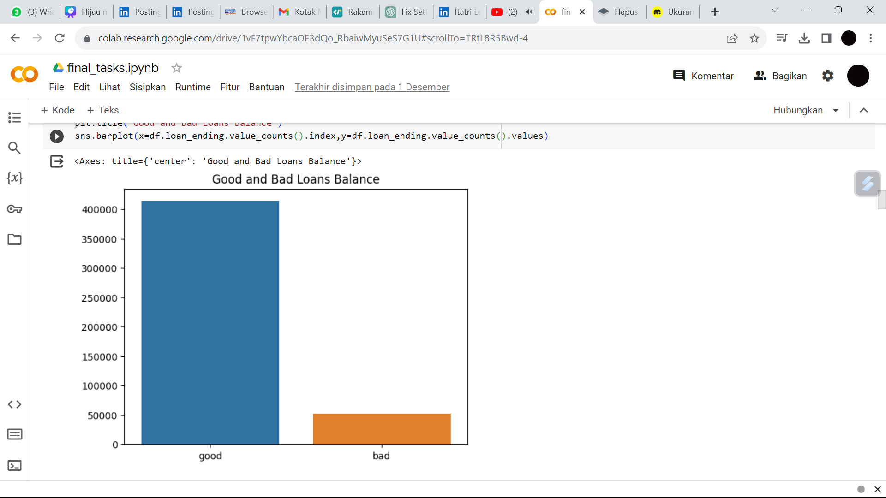


Exploratory Data Analysis
Based on the target data (loan_status) it’s divided into 2 labels, namely good_loan and bad_loan.
FINAL TASK
04

Slide 5


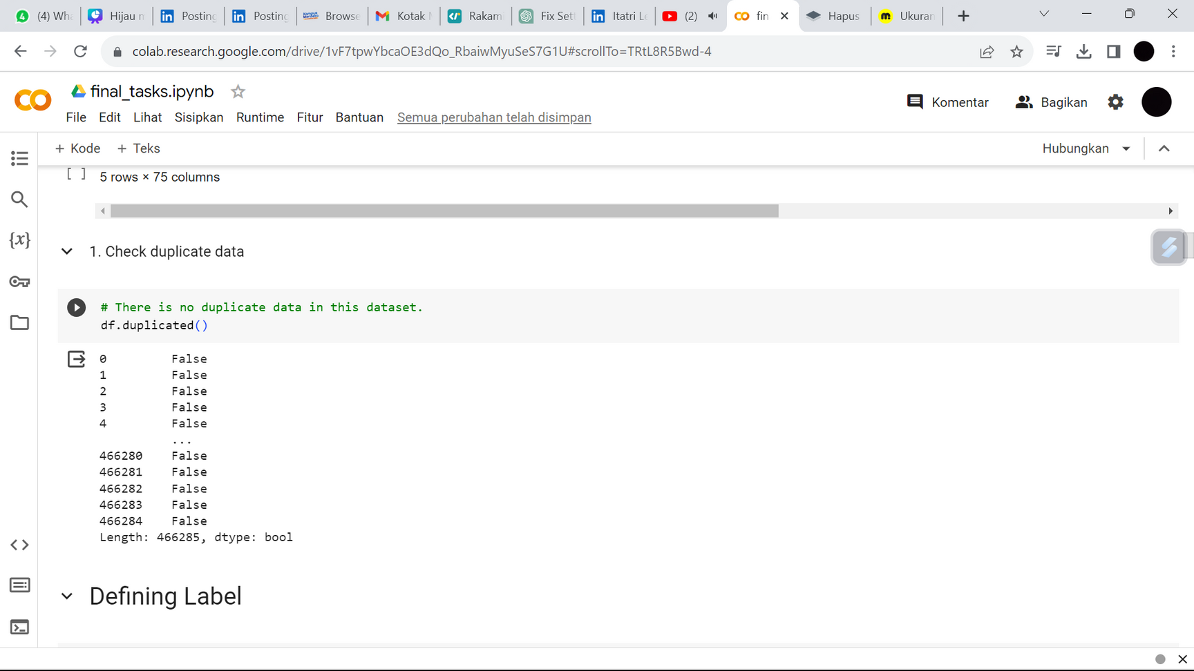
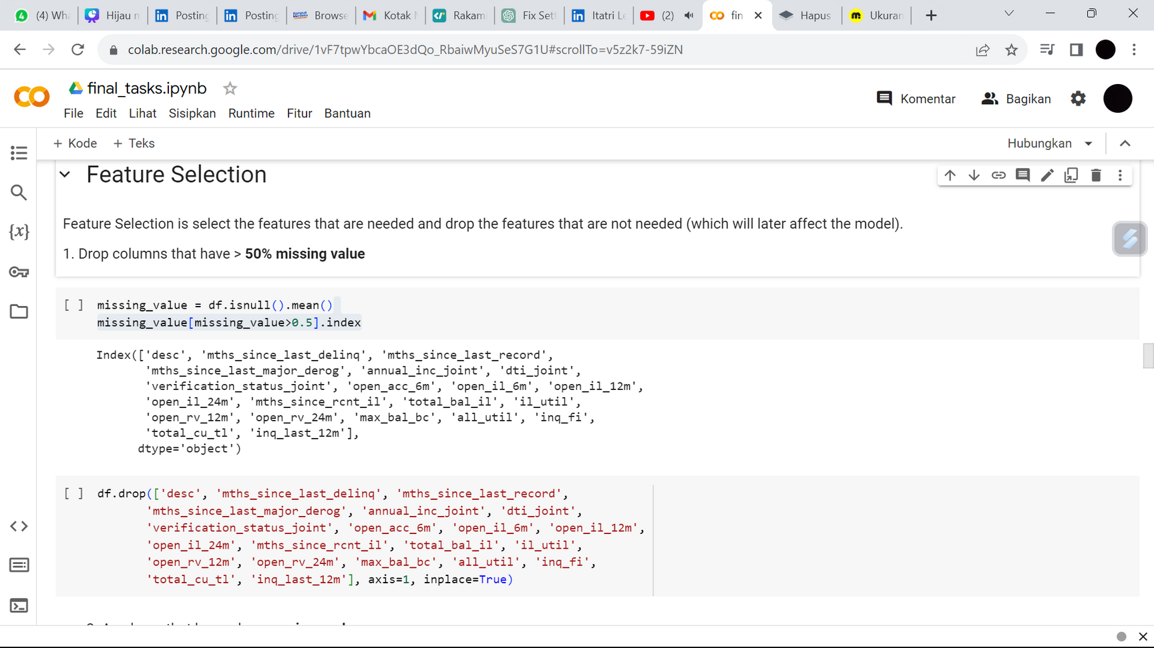
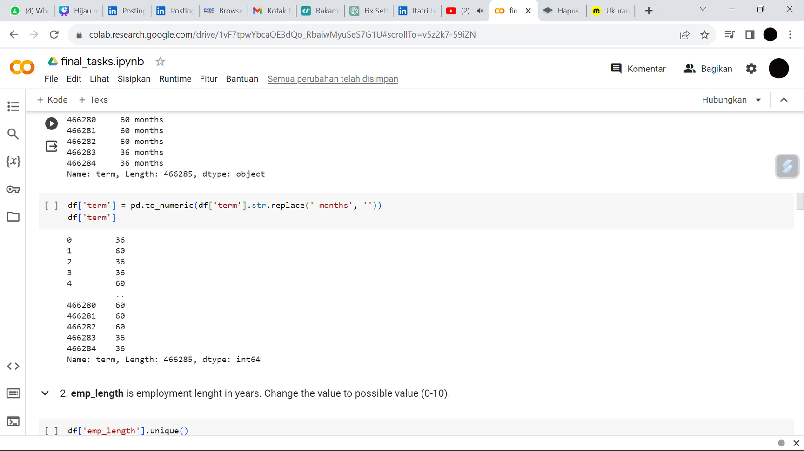
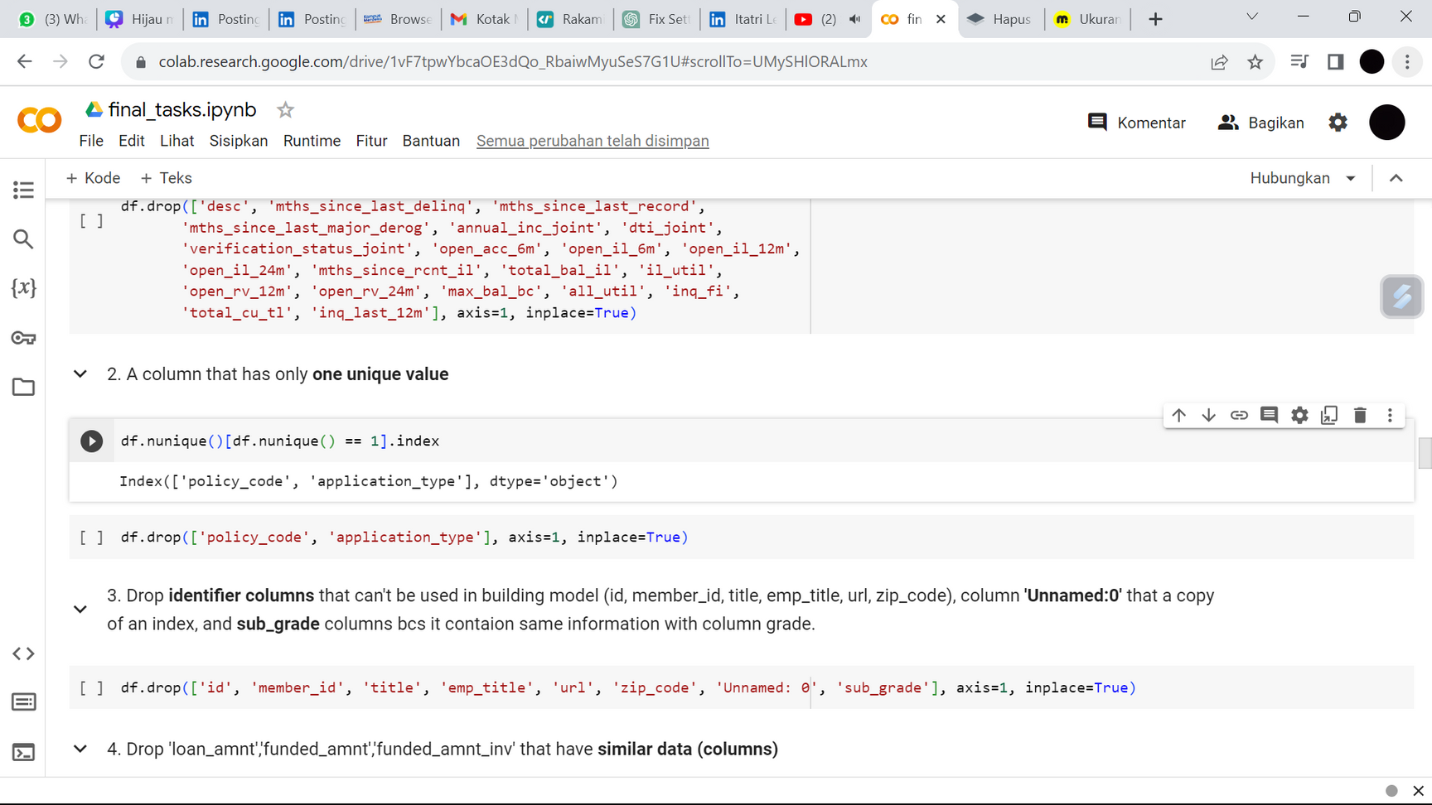
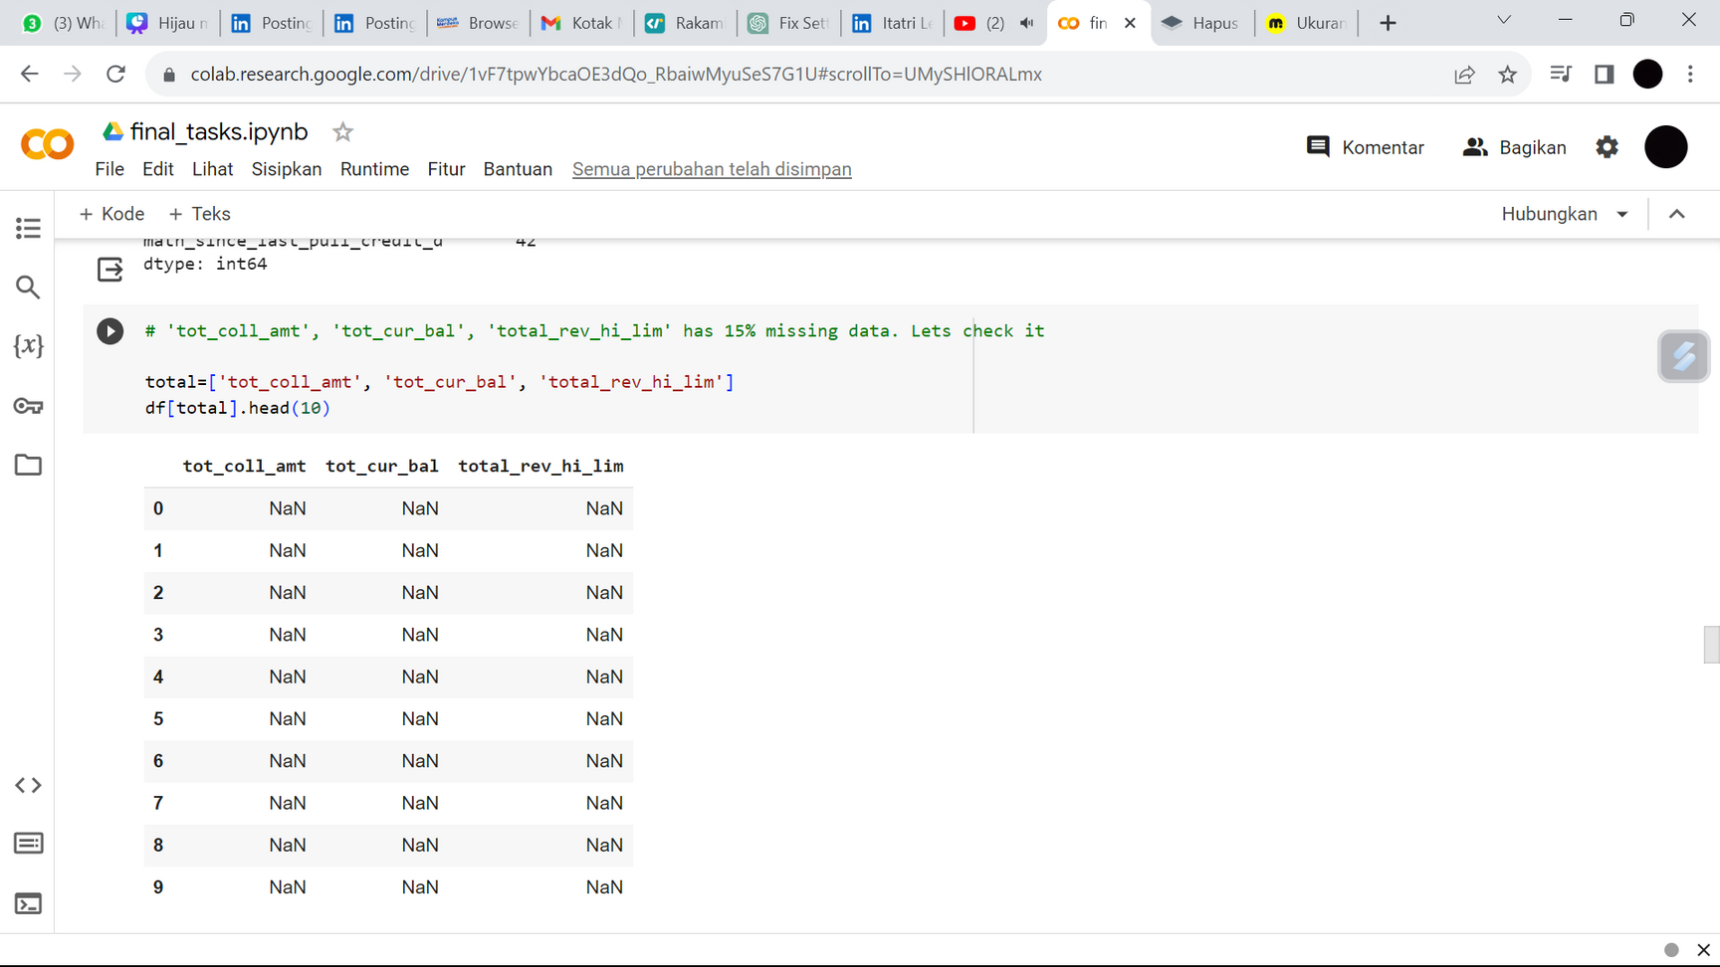
Data Preparation
Check Duplicated Data
3. Drop columns that have > 50% missing value
4. Drop a column that has only one unique value
5. Drop identifier columns, rows that have missing value, and some feature.
2. change datatypes : term, emp_length, earliest_cr_line, last_credit_pull_d
FINAL TASK
05

Slide 6
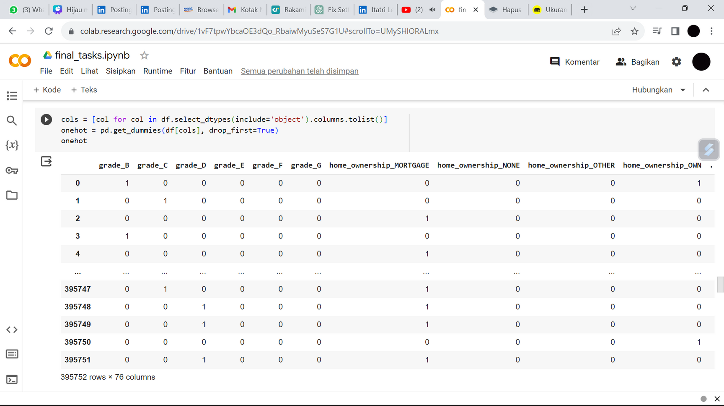
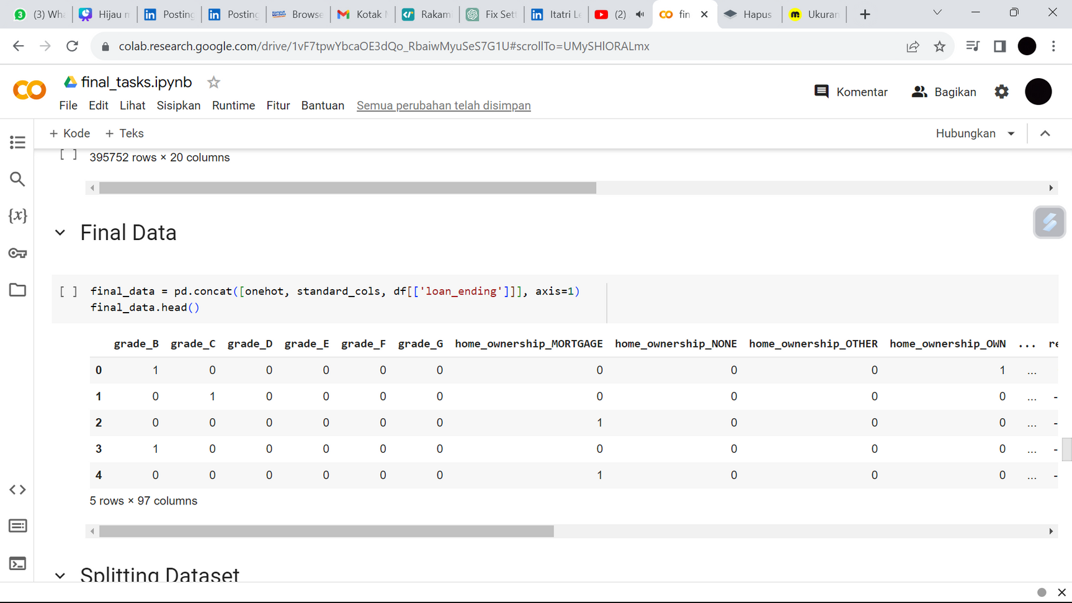
Data Preparation
6. Encoding
7. Get Final Data
FINAL TASK
06

Slide 7
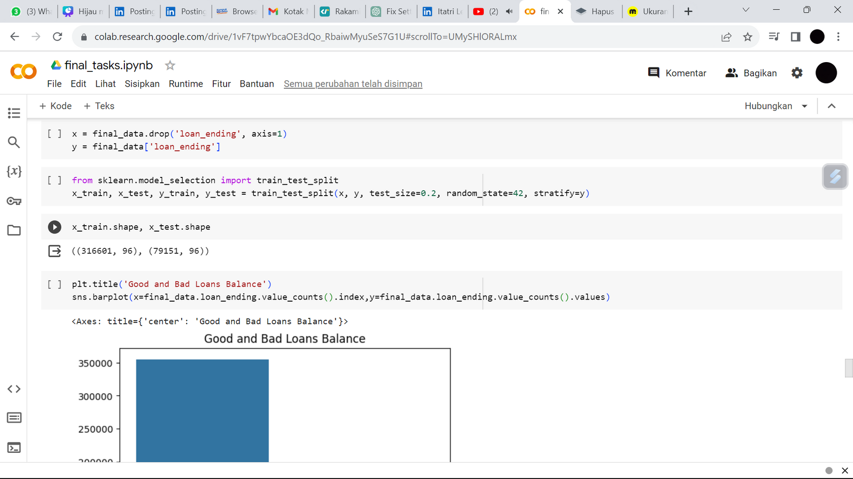

Modeling - Splitting Data
The data will be split into 80% for training and 20% for test.
FINAL TASK
07

Slide 8
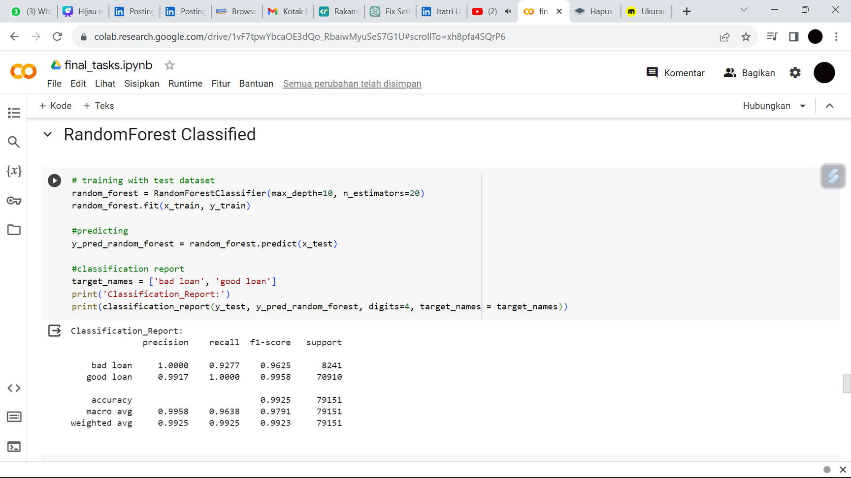
Modeling - Train
The model use RandomForest for training data.
FINAL TASK
08

Slide 9
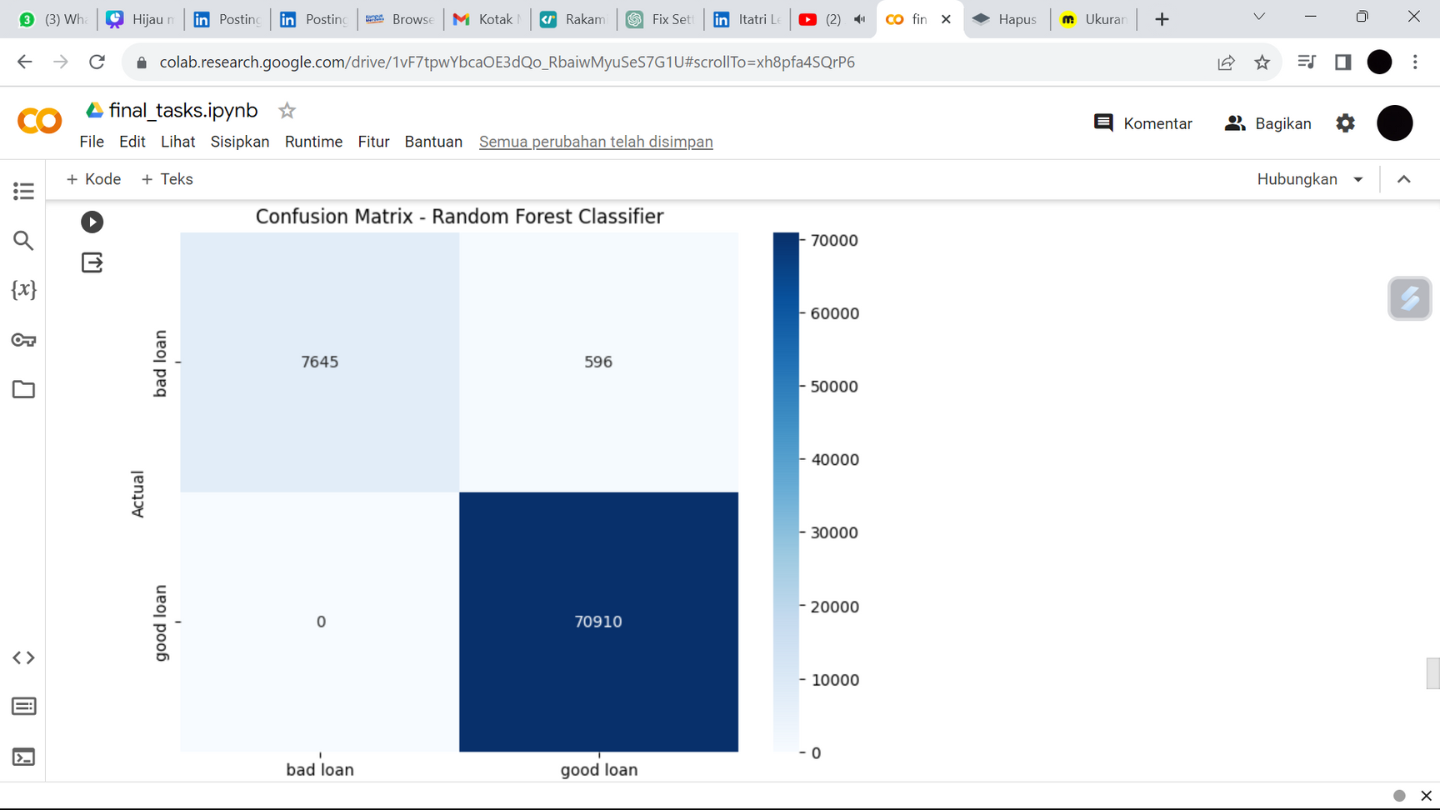
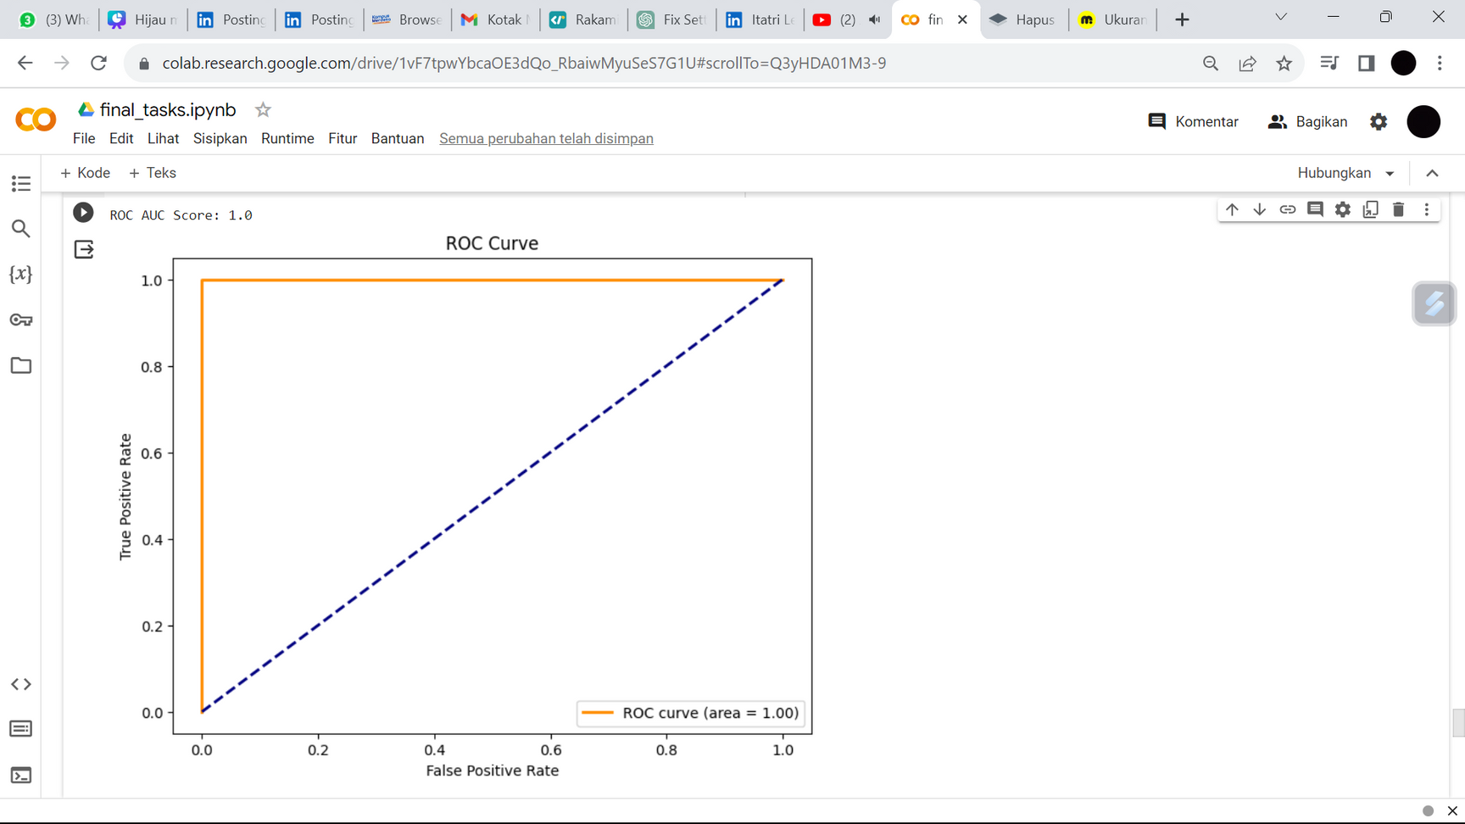
Modeling - Evaluation
This model provides prediction with 70910 True Positives and 7645 True negative.
FINAL TASK
09

Slide 10




Terima Kasih

